Slide 1
JavaScript Functions
By Faheem Ahmed

Slide 2
What's a Function?
Functions are blocks of code that execute only when you call them.
Helps to do Repetitive task.
Instead of having to type out the code every time you want something done, you can simply call the function multiple times to get the same effect. This benefit is also known as "code reusability".

Slide 3
Defining a function:
Each function in a script is given a unique name
The layout of a function always follows the same format, including these three things:
The word "function"
The function's name, followed by parentheses (which may or may not be empty)
Curly braces containing the function's code
function functionname( arguments)
{
// The function code goes here
}

Slide 4
Calling a Function:
Functions do not run automatically.
When the page loads, each function waits quietly until it is told to run.
Calling the function actually performs the specified actions.

Slide 5
There are two common ways to call a function:
From an event handler
From another function.

Slide 6
Introduction to events
JavaScript is meant to add interactivity to your pages: the user does something and the page reacts.
Therefore JavaScript needs a way of detecting user actions so that it knows when to react. It also needs to know which functions to execute

Slide 7
Events
An event occurs when a user interacts with the Web page.
Some of the commonly generated events are mouse clicks, key strokes, and so on.
The process of handling these events is known as event handling.
Following figure displays the event:

Slide 8
Event Handling
Event handling is a process of specifying actions to be performed when an event occurs. This is done by using an event handler.
An event handler is a scripting code or a function that defines the actions to be performed when the event is triggered.
When an event occurs, an event handler function that is associated with the specific event is invoked.

Slide 9
Event Handling
Following figure displays event handling:

Slide 10
Keyboard Events
Keyboard events are the events that occur when a key or a combination of keys are pressed or released from a keyboard.
These events occur for all keys of a keyboard.
The different keyboard events are as follows:
Onkeydown
Onkeyup
Occurs when a key is pressed down.
Occurs when a key is pressed and released.
Onkeypress
Occurs when the key is released.

Slide 11
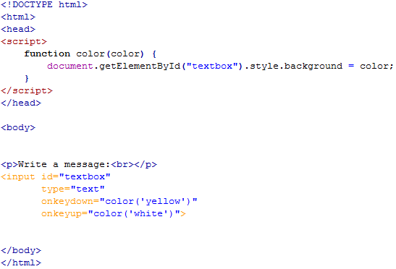

Example
Output

Slide 12
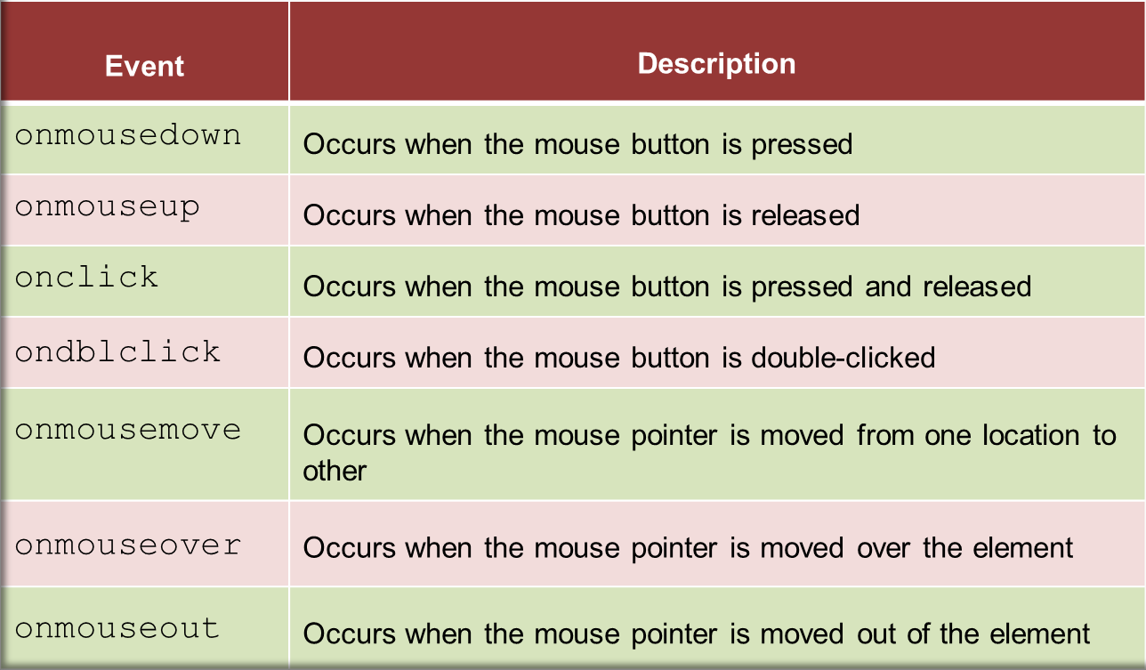
Mouse Events
Mouse events occur when the user clicks the mouse button.
Following table lists the mouse events:

Slide 13
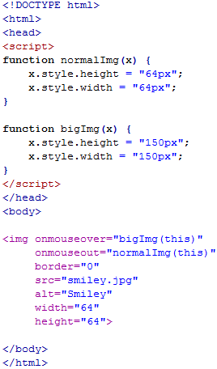


Example
Output
onmouseover
onmouseout

Slide 14
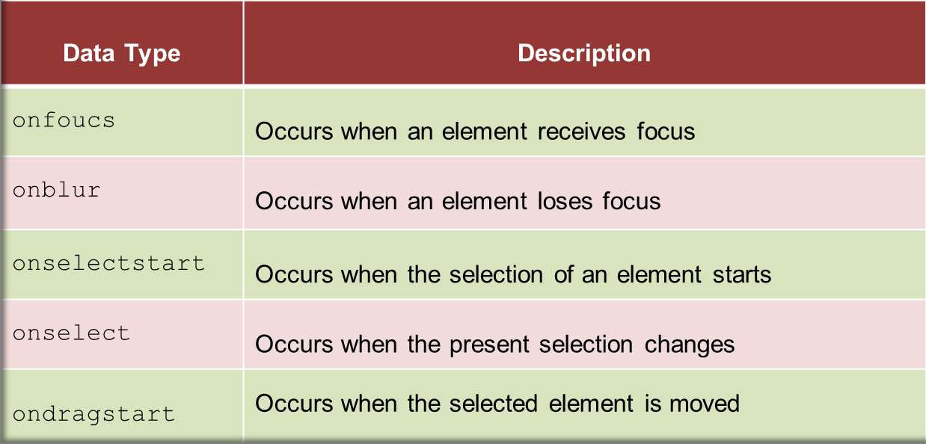
Focus & Selection Events
The focus events determine the activation of various elements that uses the element.
The selection events occur when an element or a part of an element within a Web page is selected.
Following table lists the focus and selection events:

Slide 15
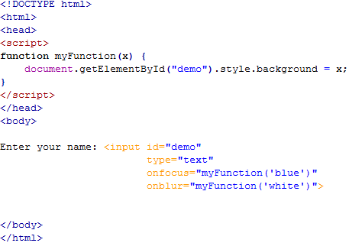

Example
Output

Slide 16
Events
Every element on a web page has certain events which can trigger a JavaScript
An event in JavaScript is something that happens with or on the webpage. A few example of events:
A mouse click
The webpage loading
Selecting an input box in an HTML form
A keystroke

Slide 17
User clicks a button (onClick):
<input type="button" value="Click Here" onclick="doSomething()">

Slide 18
User places their cursor in a text field (onFocus):
<input type="text" onfocus="doSomething()">

Slide 19
The page finishes loading (onLoad - this will run the function when the page loads, without any input from the user):
<body onload="doSomething()">

Slide 20
Examples of Functions and Events
Functions And Events
Function Calling
Function And Events

Slide 21
Calling a Function From Another Function
Functions can also call other functions.
function doSomething()
{
doSomethingElse();
This line calls the next function
}
function doSomethingElse()
{
The second function code goes here
}

Slide 22
Passing Arguments to the function:
Function can take multiple arrguments.
function fname( argument1, argument2 , ..)
{
body of function.
}

Slide 23
The return Statement
Example
The return statement is used to specify the value that is returned from the function.
So, functions that are going to return a value must use the return statement.
function product(a,b) { return a*b; }

Slide 24
The Lifetime of JavaScript Variables
If you declare a variable, using "var", within a function, the variable can only be accessed within that function.
When you exit the function, the variable is destroyed. These variables are called local variables.
You can have local variables with the same name in different functions, because each is recognized only by the function in which it is declared.
If you declare a variable outside a function, all the functions on your page can access it.
The lifetime of these variables starts when they are declared, and ends when the page is closed.

Slide 25
JavaScript Eval Function
Definition and Usage
The eval() function evaluates or executes an argument.
If the argument is an expression, eval() evaluates the expression. If the argument is one or more JavaScript statements, eval() executes the statements.
EVAL()

